Slide 1
Weakly Supervised Learning
Sungjoon Choi
Learning Deep Features for Discriminative Localization Bolei Zhou, Aditya Khosla, Agata Lapedriza, Aude Oliva, Antonio Torralba Computer Science and Artificial Intelligence Laboratory, MIT
Based on Junho Cho’s slide (@PIL SNU)

Slide 2
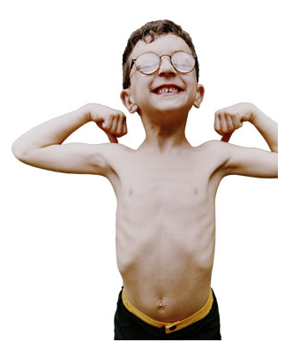
Weakly Supervised?

Slide 3
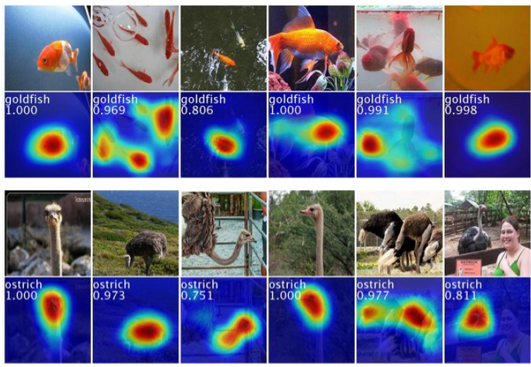
Introduction

Slide 4
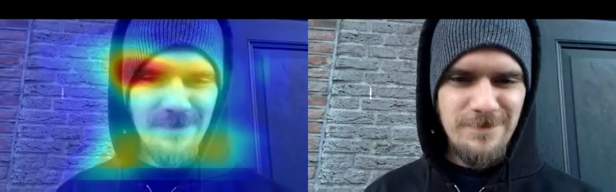
Introduction

Slide 5
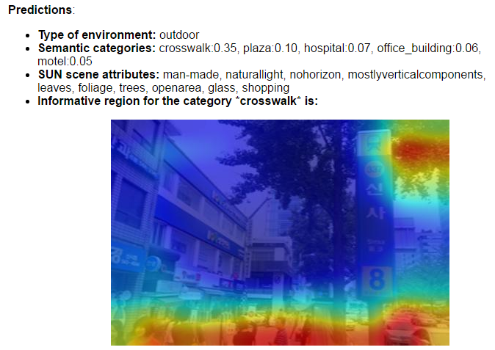
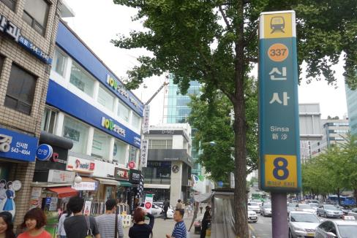
Introduction
You can try it yourself on http://places.csail.mit.edu/demo.html

Slide 6
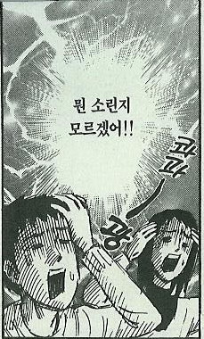
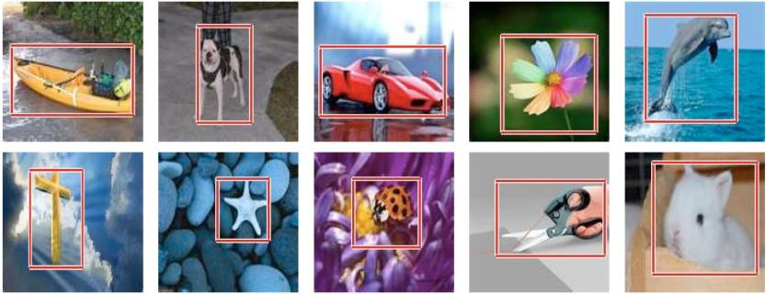
Introduction
Learning Deep Features for Discriminative Localization – CVPR2016
Weakly supervised object localization
Only trained with class label on image
Yet able to localize object very well
Close to fully supervised learned AlexNet

Slide 7
Introduction
Learning Deep Features for Discriminative Localization – CVPR2016
Visualizing the internal representation of CNNs.
Localization by Class Activation Map (CAM)
Units activated by some visual pattern within its receptive field
Visualize what activates for the output
in One CNN forward pass.

Slide 8

Lunit
https://vimeo.com/161429649

Slide 9
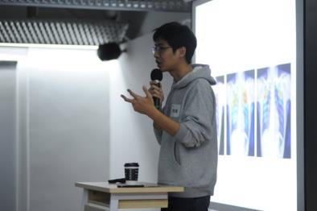
Lunit
Start-Up named after “Learning unit”
Data-driven medical image startup
But Medical images lack annotations!
Hard to get from doctors.
Annotation effort is too big.
Let’s take a look at Lunit’s presentation slides (confidential).

Slide 10
Weakly Supervised Object Localization
Usually supervised learning of localization is annotated with bounding box
What if localization is possible with image label without bounding box annotations?
Today’s seminar: Learning Deep Features for Discriminative Localization
1512.04150v1 Zhou et al. 2015 CVPR2016

Slide 11
Localization task (ILSVRC)
Classification and localize its position
ILSVRC LOC: 1000 classes and each object annotated with bounding box
Predict 5 class labels and 5 bounding boxes for each class label.
Supervised localization (VGGnet, Deep Residual Net)
Per-class regression for each class.
learn a bounding box regressor (4D vector: x, y, w, h) for each class
Train image-level classifier to predict class labels of an image.
then localization by predicting bounding boxes based on the predicted classes.
Pre-train networks for ImageNet classification and then fine-tune for localization.

Slide 12
Easy approach: localization by classification
Localization by classification model (AlexNet)
Classification map with Fully Convolutional Network instead single classification.
< Output (classes)>
< AlexNet trained on ImageNet >
cat (0.53)
cat (0.53)
6x6x256
dog (0.46)
dog (0.46)
4096
4096
1000
…
4096
4096
1000
person (0.02)
person (0.02)
cup (0.02)
cup (0.02)
Image
Convolutional layers
Fully Connected layers:
Can be considered as 1x1 convolution

Slide 13
Easy approach: localization by classification
< AlexNet trained on ImageNet >
< Output (classes)>
each 8x8 pixel classified as
227x227x3
6x6x256
What if? 451x451x3
13x13x256
cat (0.53)
4096
4096
1000
dog (0.46)
8x8x4096
8x8x4096
8x8x1000
person (0.02)
cup (0.02)
Fully Convolutional layers
Blob(Tensor) sizes
281 tiger cat
282 tabby
283 persian
Thus classification CNN already able to localize

Slide 14
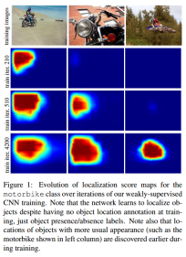
Related Works
Convolutional layers can localize objects.
The ability is lost when fully-connected(fc) layers used for classification.
Network in Network and GoogLeNet use fully convolutional network
avoid use of fc layers (except last layer)
Global pooling layer used as structural regularizer, preventing overfitting.
[Oquab et al 2015] use global max pooling to localize
Limited to point lying in the boundary of object rather tan full extent of object.
Today’s seminar: Learning Deep Features for Discriminative Localization
1512.04150v1 Zhou et al. 2015 CVPR2016
Is object localization for free? – Weakly-supervised learning with convolutional neural networks
arxiv Oquab et al. CVPR2015

Slide 15
Architecture
AlexNet+GAP+places205
Living room
11x11 Avg Pooling: Global Average Pooling (GAP)
227x227x3
11x11x512
512
205

Slide 16
Class activation map (CAM)
Identify important image regions by projecting back the weights of output layer to convolutional feature maps.
CAMs can be generated for each class in single image.
Regions for each categories are different in given image.
palace, dome, church …

Slide 17
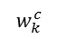
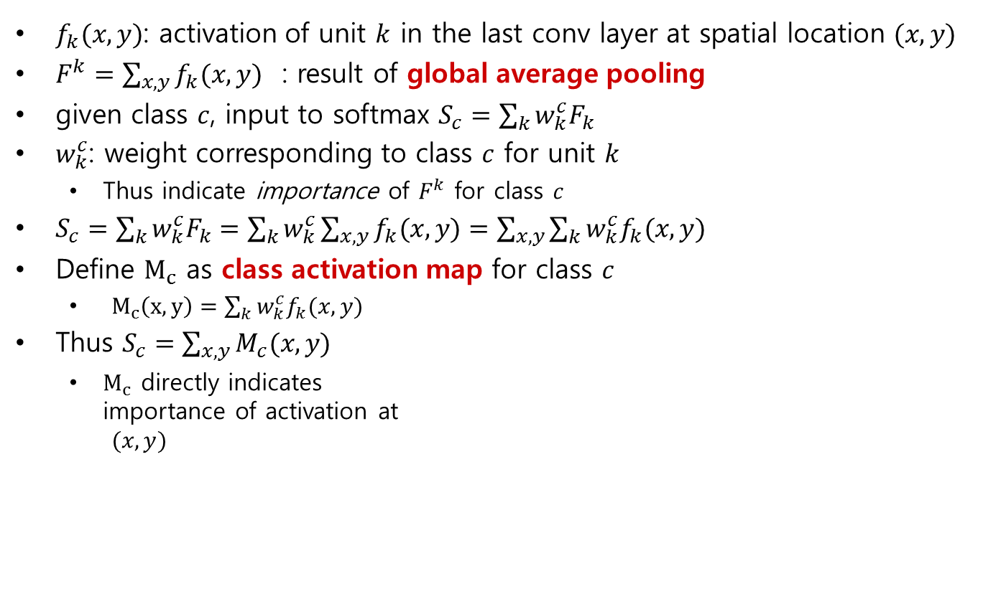
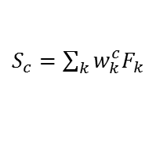
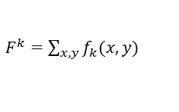
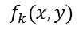
Class activation map (CAM)
$f_{k}(x,y)$: activation of unit $k$ in the last conv layer at spatial location $(x,y)$
$F^{k}=\sum_{x,y}{f_{k}(x,y)}$ : result of global average pooling
given class $c$, input to softmax $S_{c}=\sum_{k}{w_{k}^{c}F_{k}}$
$w_{k}^{c}$: weight corresponding to class $c$ for unit $k$
Thus indicate importance of $F^{k}$ for class $c$
$S_{c}=\sum_{k}{w_{k}^{c}F_{k}}=\sum_{k}{w_{k}^{c}}\sum_{x,y}{f_{k}(x,y)}=\sum_{x,y}{\sum_{k}{w_{k}^{c}f_{k}(x,y)}}$
Define $M_{c}$ as class activation map for class $c$
$M_{c}\left(x,y\right)=\sum_{k}{w_{k}^{c}f_{k}(x,y)}$
Thus $S_{c}=\sum_{x,y}{M_{c}(x,y)}$
$M_{c}$ directly indicates importance of activation at $(x,y)$
$F^{k}=\sum_{x,y}{f_{k}(x,y)}$
$$f_{k}(x,y)$$
$S_{c}=\sum_{k}{w_{k}^{c}F_{k}}$
$$w_{k}^{c}$$

Slide 18
Results
CAM on top 5 predictions on an image
CAM for one object class in images

Slide 19
GAP vs. GMP
Oquab et al. CVPR2015 Is object localization for free? weakly-supervised learning with convolutional neural networks.
Use global max pooling(GMP)
Intuitive difference between GMP and GAP?
GAP loss encourages identification on the extent of an object.
GMP loss encourages it to identify just one discriminative part.
GAP, average of a map maximized by finding all discriminative parts of object
if activations is all low, output of particular map reduces.
GMP, low scores for all image regions except the most discriminative part
do not impact the score when perform MAX
pooling

Slide 20
GAP & GMP
GAP (upper) vs GMP (lower)
GAP outperforms GMP
GAP highlights more complete object regions and less background noise.
Loss for average pooling benefits when the network identifies all discriminative regions of an object

Slide 21
Experiments!
AlexNet, VGGnet, GoogeLeNet : Trained with ImageNet from the scratch
All remove Fully Connected(FC) layers
Replace with GAP & FC softmax layer
Better if Conv layer before GAP has higher spatial resolution
mapping resolution
Removed last conv layer and add higher spatial resolution
Ex) VGGnet: Conv5-3 3x3x512 → 3x3x1024

Slide 22
AlexNet, VGGnet, GoogLeNet
Reminder on popular nets.
GoogeLeNet is most convolutional among these.
Performs the best

Slide 23
Classification
Classification error:
1~2% performance drop on Top-5
AlexNet-GAP drops with removal of FCs
GooLeNet-GMP & GooLeNet-GAP is similar
High classification performance is important to achieve good localization
as it involves identifying both object category and bounding box location

Slide 24
Localization
Generation of Bounding Box from CAM.
thresholding to segment the heatmap
20% of the max value of CAM, cover with bounding box.
on Top 5 predicted classes.
GT bounding box

Slide 25
Localization
Weakly vs. weakly
GoogLeNet-GAP beats GoogLeNet and GoogLeNet-GMP
Weakly-supervised!!
Not trained on single annotated box.
Weakly vs. fully-supervised
(heuristic)
loose bbox from top 3rd predicted class.
GoogLeNet-GAP is closed to AlexNet that learned supervised method.
Impressive but still behind fully-supervised.

Slide 26
Deep Features for Classification
Usage CNN features (fc6, fc7 of AlexNet) as a generic feature
→ Used as very powerful feature without training on the task.
Use the features learned by GAP CNN. Not trained for particular task!
Obtain weights by training a linear SVM on the output of GAP layer
similar to mapping weight to softmax layer
Compare performance.
GoogLeNet-GAP outperforms AlexNet.
GoogLeNet-GAP is competitive with the state-of-the-art as generic visual features.

Slide 27
Deep Features for Localization
Also localizable with CAM
Very effective for generating localizable deep features for generic tasks.

Slide 29
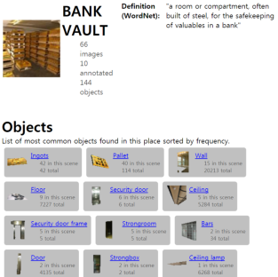
Scene Recognition + Localization
10 scene categories from SUN dataset. 4675 fully annotated images.
one-vs-all linear SVM for each scene category.
Compute the CAMs using the weights of the linear SVM.
Plot CAM for predicted scene category
list top 6 objects that most frequently overlap
High activations regions correspond to objects indicative of the particular scene category.

Slide 30
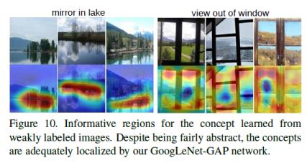
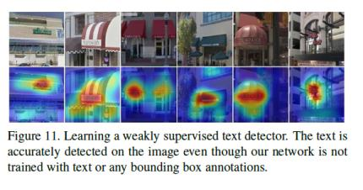
Concept localization
Concept localization in weakly labeled images
Positive set: short phrase in text caption
Negative set: randomly selected images
Model catch the concept, phrases are much more abstract than object name.
Weakly supervised text detector
Positive set: 350 Google StreeView images that contain text.
Negative set: outdoor scene images in SUN dataset
Text highlighted without bounding box annotations.

Slide 31
Conclusion
General technique called Class Activation Mapping (CAM) with Global Average Pooling has been proposed
Classification-trained CNNs can learn object localization.
without bounding box annotations.
CAM is useful to visualize the predicted class scores.
Highlights discriminative object parts detected by CNN.
Weakly-supervised object localization on ILSVRC benchmark, and GAP-CNN can perform accurate object localization.
CAM localization technique generalized to other visual recognition tasks.
Generic localizable deep features applicable to various tasks.
Import object in scene, concept localization, text detection.

